Slide 1
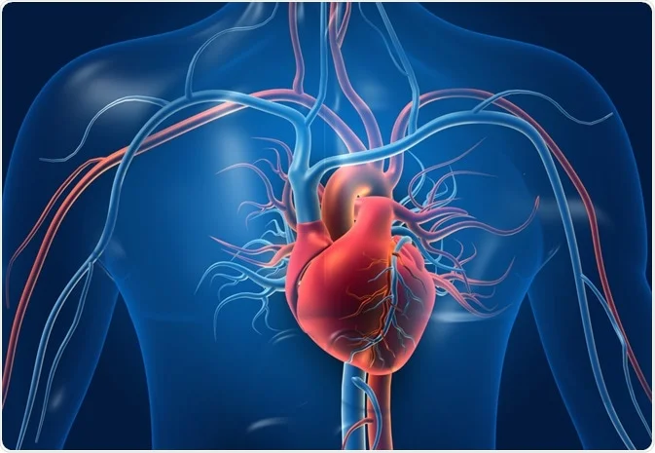
Prediction of Cardiovascular Disease By Decision Tree
Team Members
Sai Shruthi Cherukuri
Chetan Mylapilli
Tejesh Bathula
Joshna Mereddy
Leela Hari Priya Ginakunta

Slide 2
Agenda
Introduction
Techniques to treat problem
Primary goal
Analysis of data also includes visualization
Data Preprocessing
Methodology
Result
Conclusion

Slide 3
Introduction
Heart disease is a very serious issue and innumerable people suffer from this disease across the world. Heart disorders come in a variety of forms. They are arrhythmia, coronary artery disease, heart attack, chest pain, stroke, irregular heartbeat, and heart disease at birth. The key contributors to an elevated risk of heart disease include improper lifestyle choices, a poor diet, insufficient exercise, a high BMI, and smoking. And your family’s medical history may contribute to heart disease. The leading cause of death worldwide is heart disease. WHO estimates that 17.5 million individuals worldwide passed away from heart disease in 2005, accounting for 31% of all fatalities.

Slide 4
Techniques To Treat The Problem
Your doctor may perform a physical examination, order blood tests, or use other tests to check for problems with your heart or blood vessels. These tests can help them diagnose heart disease and develop a treatment plan.
The early solution for prediction of heart disease at early stages is by using Machine Learning models. Machine Learning will predict the heart disease with the help of features.
Data Collection
Data Preprocessing
Model Building
Prediction

Slide 5
Primary Goal
The main aim of this research is to predict cardiovascular disease by implementing a classification model, which serves a primary classifier. Decision tree is a supervised machine learning technique used in classification and regression modeling.
The decision tree employs number of algorithms, including ID3, C4.5, CART, and CHAID. After building the Decision tree classifier if our model is overfitted we have an optimization technique called Pruning.
Moreover, in this research along with the Decision Trees other Machine Learning algorithms like Logistic Regression, Random Forest, K-Nearest Neighbors, Naive Bayes are being compared for prediction of heart disease and to calculate the performance of all the algorithms in this model.

Slide 6
Analysis of Dataset
For Prediction of Cardiovascular disease, we have the dataset ‘processed_cleveland.CSV’. Taken from Kaggle Repository.
In the dataset we have 14 columns and 303 records or rows.
The dataset contains 1 float columns, 11 int columns & 2 object columns.

Slide 7
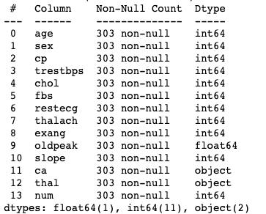
Data Information
The dataset contains 1 float columns, 11 int columns & 2 object columns.
From the above data ‘num’ is considered as Target Variable. It predicts whether the person may suffering from heart disease or not.

Slide 8
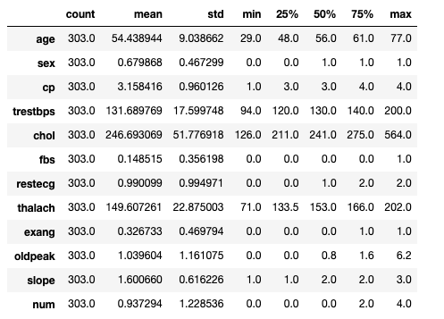

Data Descritption
Numerical Data
Categorical Data

Slide 9
Work Flow

Slide 10
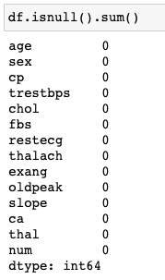
Null Values
From this dataset we have found there are 0 null values. So, there is no need of any imputations.

Slide 11
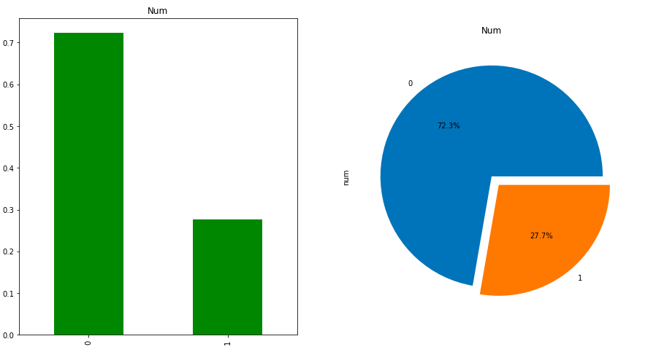
Visualization
Target Variable
In this dataset ‘num’ is considered as the target variable.
From the above chart we can infer 27.7% of the data is saying ‘yes’ and ‘72.3’ of the data is saying ‘no’

Slide 12
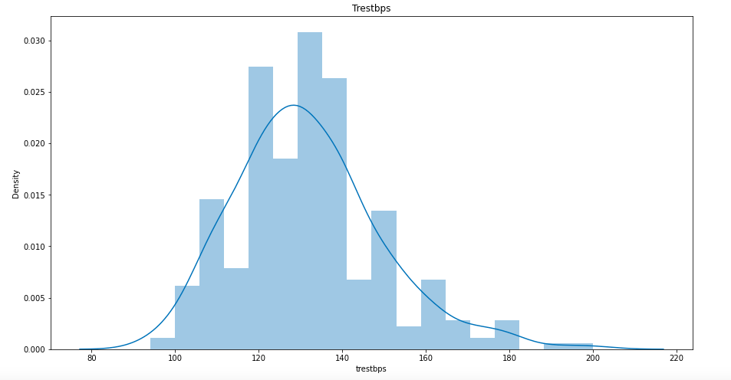
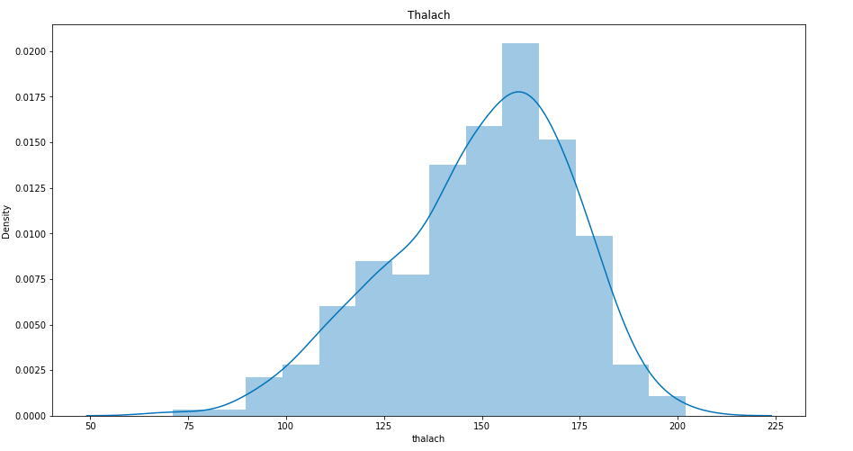
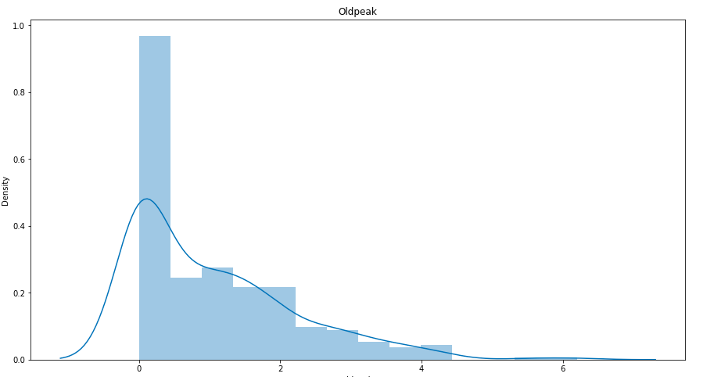
Trestbps
Thalach
Oldpeak
Trestbps resting blood pressure (in mm Hg on admission to the hospital)
From the above plot we can infer Trestbps is normally distributed.
Thalach : maximum heart rate achieved )
From the thalach we can say that it is normally distributed.
oldpeak: ST depression induced by exercise relative to rest)
From the oldpeak plot we can say that it is right skewed.

Slide 13
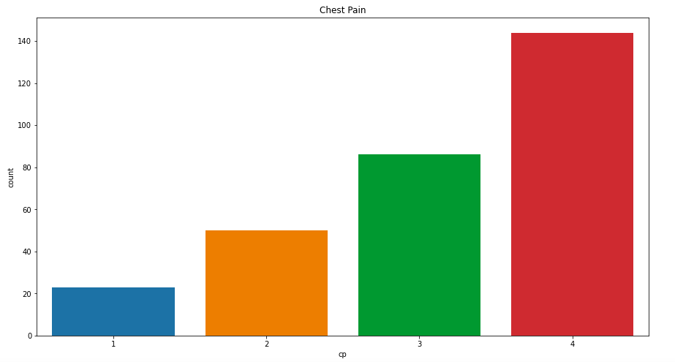
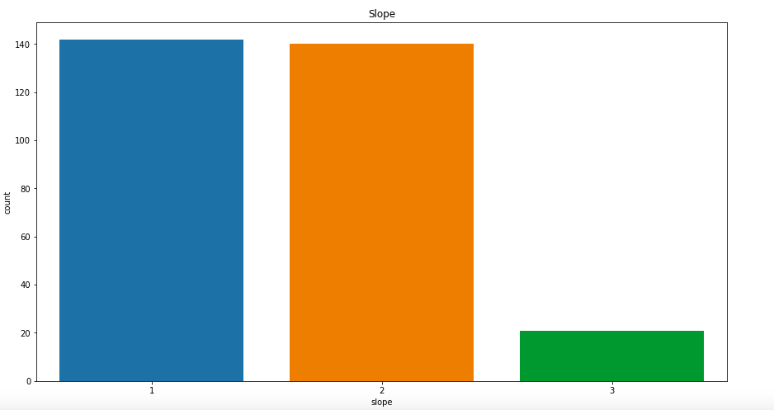
Chest Pain
Slope
chest pain type - Value 0: typical angina
Value 1: atypical angina
Value 2: non-anginal pain
Value 3: asymptomatic
the slope of the peak exercise ST segment Value 0: upsloping Value 1: flat
Value 2: downsloping

Slide 14
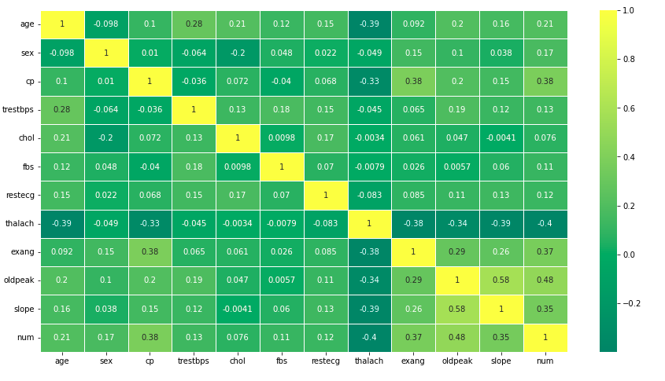
Heat Map
Heatmap infers How variables are correlated with each other
From the above heatmap we can see slope is highly correlated with oldpeak - 0.58
Num is correlated with oldpeak – 0.48
Cp is correlated with num & exang – 0.38
We can observe that there is presence of multicollinearity between various features.

Slide 15
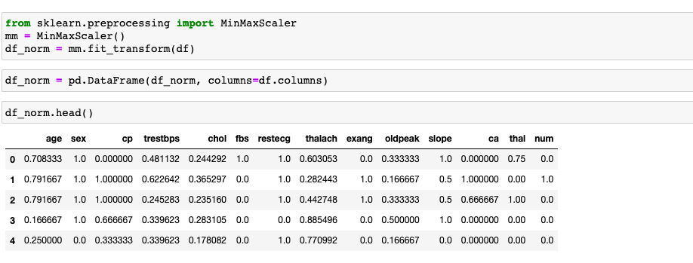
Normalizing the data
Before normalizing the data, we faced the challenges in the column's ‘ca’ and ‘thal’ in only 6 rows so instead of imputing those 6 rows we dropped those rows which will not affect the accuracy of the data much.
Now the shape of the dataset have been changed to 297 rows from 303 rows after dropping them.
For normalizing the data, we used MinMaxScaler. In which MinMaxScaler will transform the data into 0-1 scale.

Slide 16

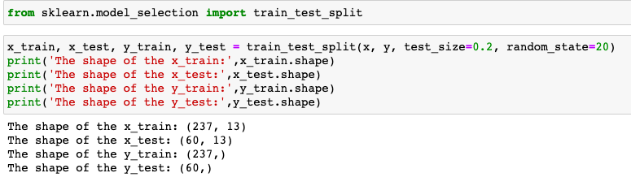
Splitting the data
Before splitting the data, we considered the ‘X’ and ‘Y’ variables which ‘Y’ is target variable, and ‘X’ is remaining variables in the data.
After considering ‘X’ & ’Y’ we splitted the data using Train Test Split with testing size 20% and the training size 80%.
The above shape shows the data after splitting into x_train, x_test, y_train and y_test.

Slide 17
Model Building
In this we performed various models :-
Logistic regression (solver = ‘saga’) We also considered the models like :-
Random Forest 1. ID3 Algorithm
K Nearest Neighbors (metrics = ‘Euclidean’) 2. C4.5 Algorithm
Naïve Bayes 3. Cart Algorithm
XG Boost But, the above 3 algorithm considered our data as
Decision Tree Base model numerical so it predicted the metrics like
Decision Tree pre pruning 1 MSE, MAE, RMSE, RAE. Which is not relatable for
Decision Tree pre pruning 2 prediction of the data. So, we did not considered
Decision Tree post pruning the above algorithms.
Weight voting classifier

Slide 18
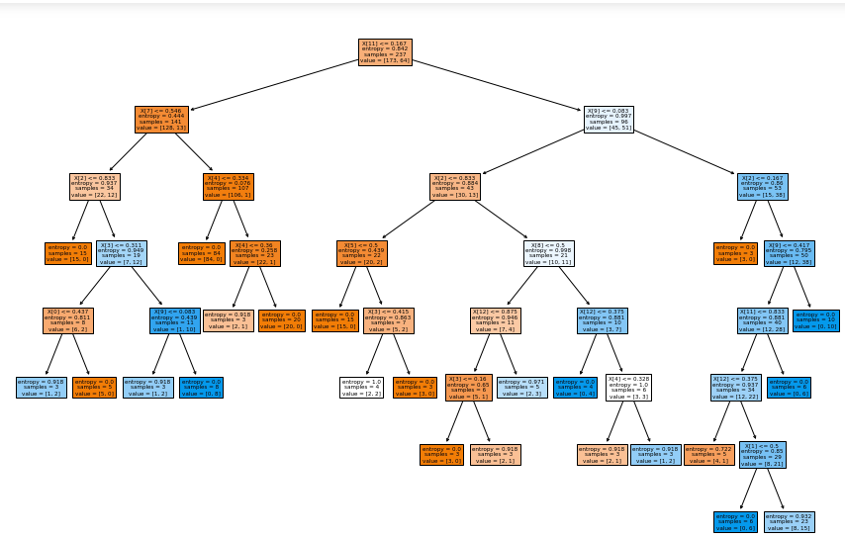
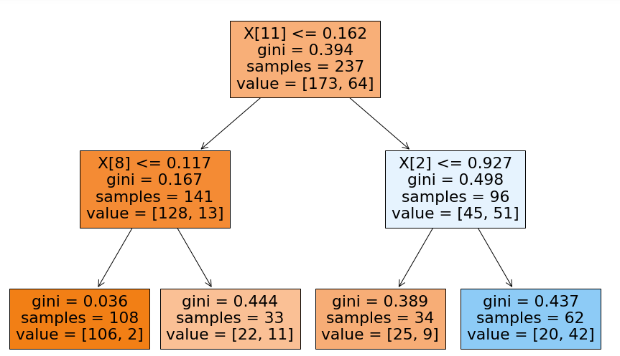
Decision Tree
Decision tree pre pruning 1 algorithm
Decision tree pre pruning 2 algorithm
'criterion': 'entropy', 'max_depth': 7, 'min_samples_leaf': 3, 'min_samples_split': 5,
'splitter': 'best'
'criterion': 'gini', 'max_depth': 2, 'min_samples_leaf': 8, 'min_samples_split': 8, 'splitter': 'random'
The difference between the decision tree prepruning 1 and 2 is as shown above. The tree with criterion = ‘gini’ max_depth 2, min_samples_leaf = 8, min_samples_split = 8, splitter = ‘random’ predicted well when compared with 1st prepruning technique which will be shown in results table.

Slide 19
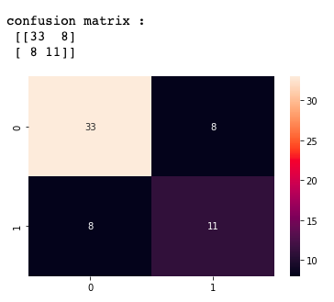
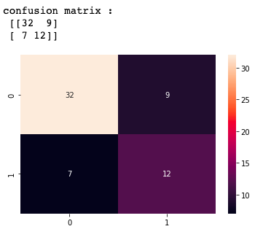
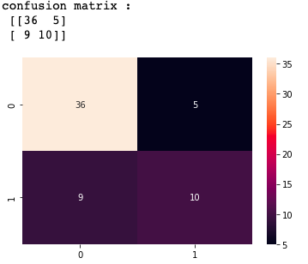
Results of Decision Tree
The above decision tree base model
TP = 33
FP = 8
FN = 8
TN = 11
The above decision tree prepruning 1
TP = 32
FP = 9
FN = 7
TN = 12
The above decision tree prepruning 2
TP = 36
FP = 5
FN = 9
TN = 10

Slide 20
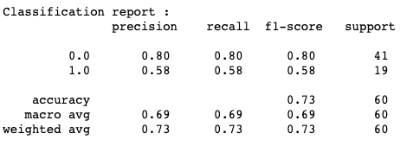
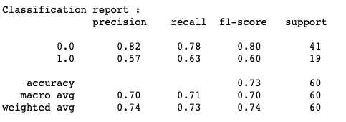
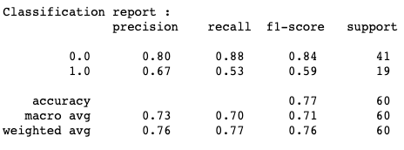
Classification report of Decision Tree
From the above classification report of the various decision tree when compared to decision tree base model & decision tree pre pruning techinique 1, Decision tree pre pruning technique 2 predicted well with accuracy of 77%.
Whereas the accuracy of the decision tree base model – 73%
Whereas the accuracy of the decision tree pre pruning1 model – 73%
Whereas the accuracy of the decision tree pre pruning2 model – 77%
So, when compared to all the 3 models decision tree pre pruning2 model is predicting well.

Slide 21
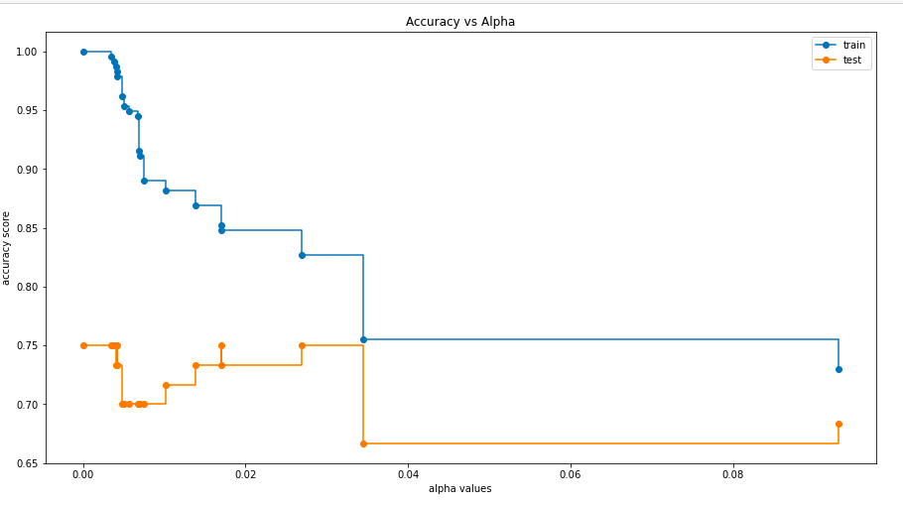
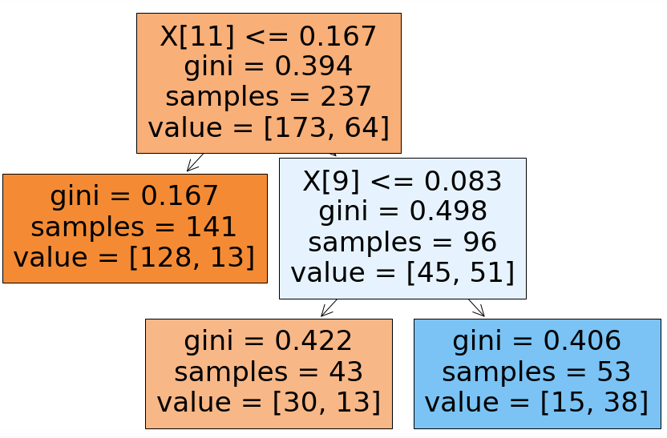
Decision Tree post pruning technique
For Decision Tree post pruning classifier, we considered (ccp_alpha=0.03, random_state=0) as the curve of train data and curve of testing data is found close at that point.

Slide 22
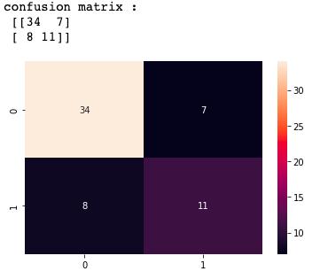
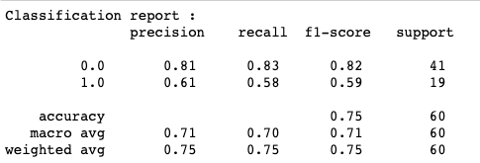
Results of Decision Tree Post Pruning model
The above decision tree base model
TP = 34
FP = 7
FN = 8
TN = 11
From the above classification report the accuracy of the post pruning model is predicted 75%.
Which is also less than decision tree pre pruning model 2.

Slide 23
Weight Voting Classifier
Weight Voting classifier is the combinations of different machine learning models in this research we considered , the machine learning models like Naïve Bayes, Logistic Regression, Random forest classifier, K Nearest Neighbors, XG Boost, Decision Tree Pre pruning1.

Slide 24
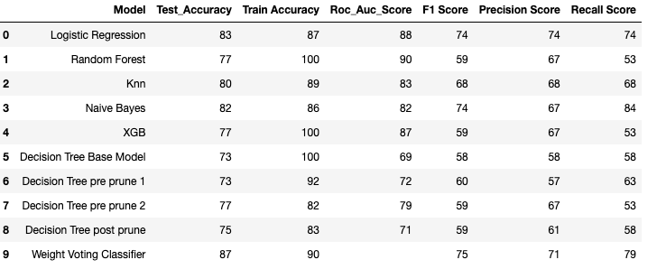
Results
From the above table we can infer that Weight Voting Classifier is the best model with accuracy of 87%.
Also, The F1 Score, Recall score obtained good for Weight Voting Classifier.
From the above table we are selecting Weight Voting Classifier is the best model to predict whether the particular is/may suffer from heart disease.

Slide 25
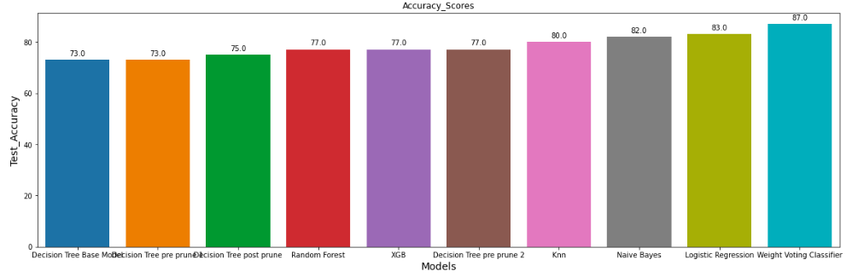
Results Visualization

Slide 26
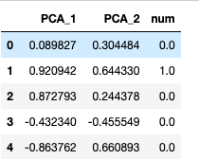
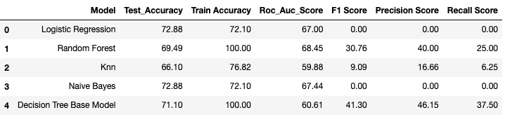
PCA Method for the data
We also performed dimensionality reduction method which is PCA by considering 2 components to check whether the accuracy will increase or not for all the models but unfortunately, we failed to increase the accuracy of all the models when compared to the above models.

Slide 27
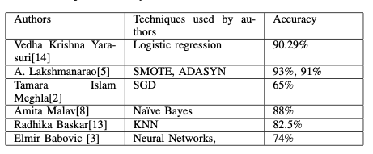
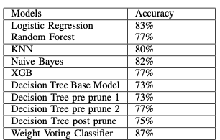
Results comparison from previous study
Accuracy of this research
Accuracy of the previous study

Slide 28
Conclusion
A system that can anticipate cardiac disease at an early stage is needed. By using this automated method, people may keep track of their health difficulties, which will be helpful for both the doctor and the patient in terms of accurate diagnosis. Research work has been employed with the machine learning classifiers to find out the stroke accurately in a person. Weight voting classifier has considered features like age, sex, cp, trestbps, chol, fbs, restecg, thalach, exang, oldpeak, slope, ca, thal which helped to get the highest accuracy of about 87% when compared to all the accuracies used in research. As a result, weight voting classifier can be considered for the prediction of cardiovascular disease in a person. And we can recommend doctors who are diagnosing the heart disease in person.

Slide 29

THANK YOU

